Slide 1

Digitalization of an Insurance Application Process
A process for the people of tomorrow

Slide 2
How can we make the process of applying for insurance user friendly and digital at the same time?
Notes:
We took on the challenge of coming up with a new process for people to apply for insurance. While designing the new process we tried to answer the following question: How can we make the process of applying for insurance digital, but also user friendly.

Slide 3
How can we make the process of applying for insurance user friendly and digital at the same time?
Notes:
We took on the challenge of coming up with a new process for people to apply for insurance. While designing the new process we tried to answer the following question: How can we make the process of applying for insurance digital, but also user friendly.

Slide 4
Who are our users?
Notes:
So to make it user friendly we first had to define , who our users are.

Slide 5
“Tech savvy people between the age of 18 and 45 who are interested in having an uncomplicated way to apply for insurance through digital channels rather than face to face through an insurance broker.”
Notes:
We used the following definition for our target group

Slide 6
How can we make the process of applying for insurance user friendly and digital at the same time?
Notes:
Now for the second part of our question: the digital aspect of the question

Slide 7
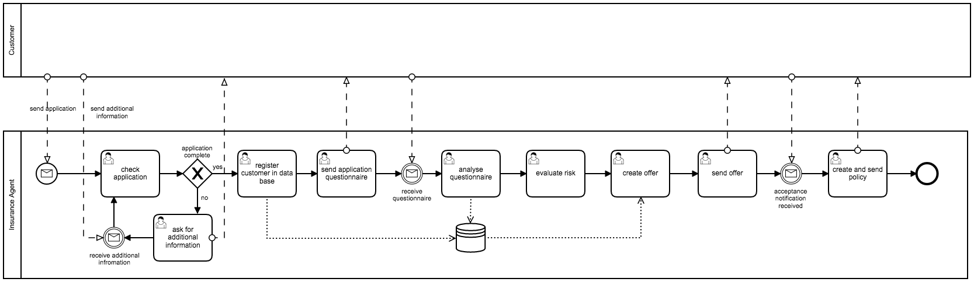
Notes:
To make a process digital we first have to take a look at what a typical process looks like today. When looking at a typical non digitalized process for applying for insurance it becomes clear that it involves a lot human interaction. What we see here is a typical insurance application process which is tedious and consists of over 9 human decision making or processing tasks.

Slide 8
Notes:
To make a process digital we first have to take a look at what a typical process looks like today. When looking at a typical non digitalized process for applying for insurance it becomes clear that it involves a lot human interaction. What we see here is a typical insurance application process which is tedious and consists of over 9 human decision making or processing tasks.

Slide 9
Notes:
To make a process digital we first have to take a look at what a typical process looks like today. When looking at a typical non digitalized process for applying for insurance it becomes clear that it involves a lot human interaction. What we see here is a typical insurance application process which is tedious and consists of over 9 human decision making or processing tasks.

Slide 10
Notes:
To make a process digital we first have to take a look at what a typical process looks like today. When looking at a typical non digitalized process for applying for insurance it becomes clear that it involves a lot human interaction. What we see here is a typical insurance application process which is tedious and consists of over 9 human decision making or processing tasks.

Slide 11
Notes:
To make a process digital we first have to take a look at what a typical process looks like today. When looking at a typical non digitalized process for applying for insurance it becomes clear that it involves a lot human interaction. What we see here is a typical insurance application process which is tedious and contains over 9 tasks consisting of human decision making or processing.

Slide 12
A customer can apply for insurance using a simple form of communication and without human interaction.
Notes:
So by trying to answer that question and from the state of a typical as is process we created the following hill to have as our fixpoint on the horizon.

Slide 13
Our Solution
Notes:
So with what concept did we come up with?

Slide 14
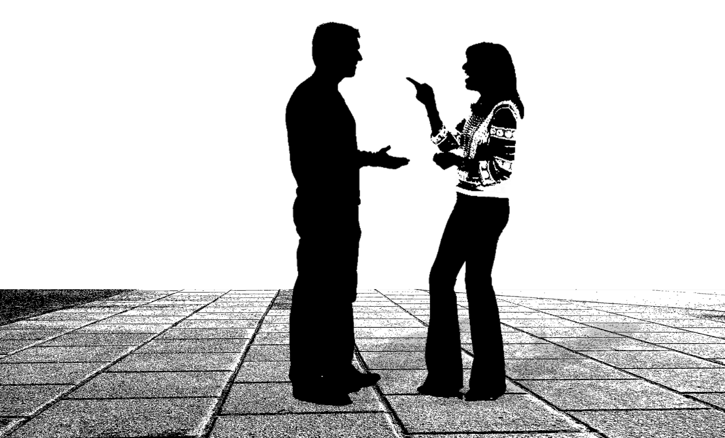
Notes:
In order to make it as simple as possible for humans to start and use our process and also as natural as possible we relied on a concept which every human is familiar with from the beginning on. Something little called: Human interaction and more precisely: Conversation

Slide 15
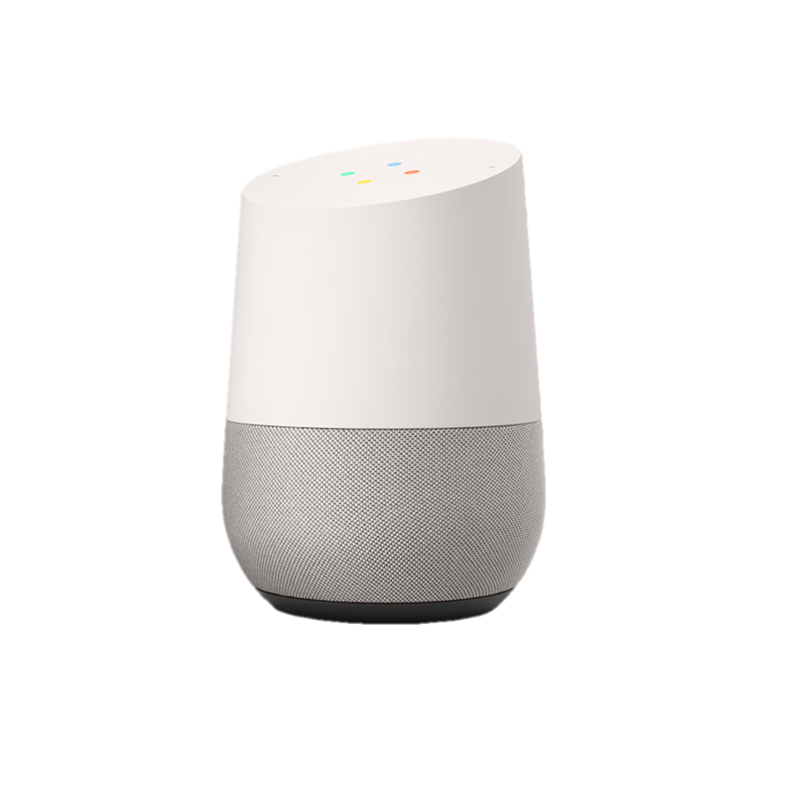
Notes:
. Using natural language as an input was the logical choice! We therefore decided to use google assistant and dialogflow as the starting point for our conversation.

Slide 16
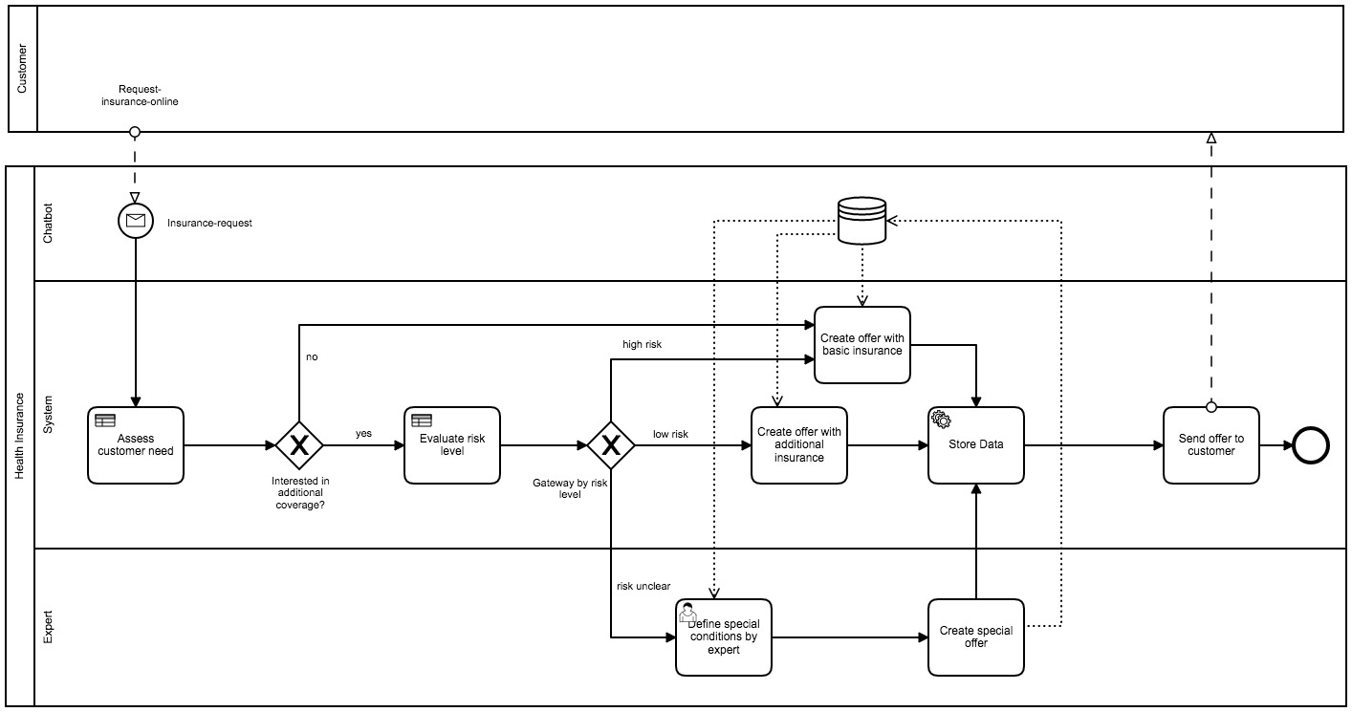
Notes:
Building on that idea we came up with the following process. Which Dominik will shortly explain to you.

Slide 21
Customer

Slide 23
…in Action
Our Solution
Notes:
And now for our solution in Action

